Slide 1

Prognostics Modelling for Engine Degradation
Lorenzo Castro Ventas – Master Data Science Kschool Ed. 26

Slide 2
INDEX
Topic brief explanation
Dataset acquisition
Dataset analysis
Modelling and Algorithms
Results to be presented
Issues to be expected

Slide 3
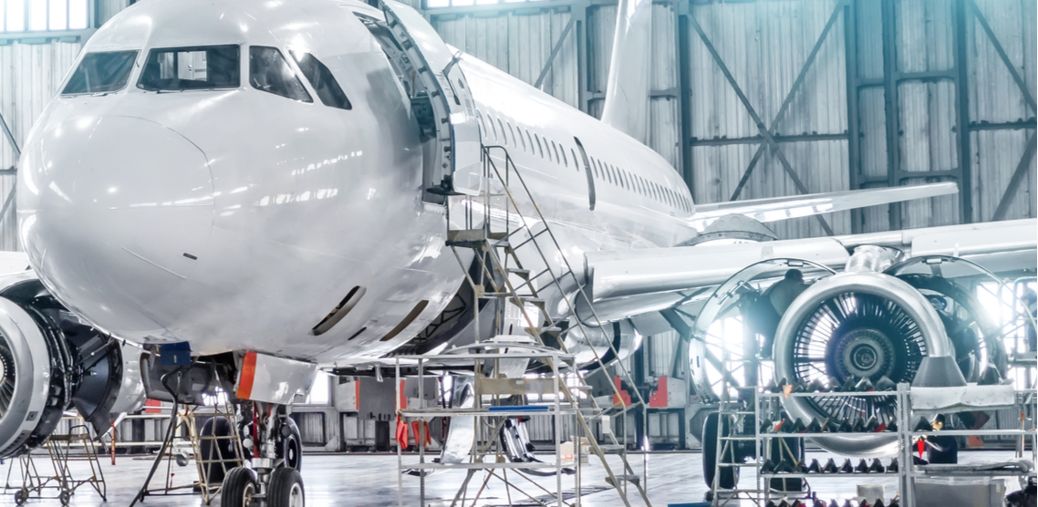
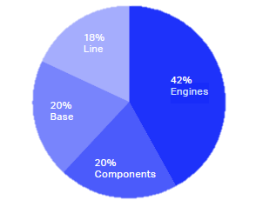
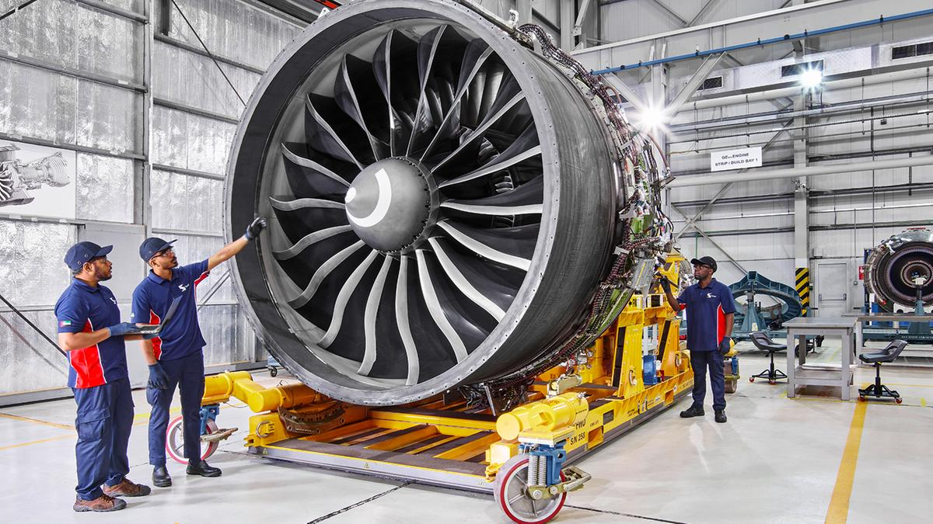
Topic brief explanation
MRO (Maintenance Repair and Overhaul) market spent by segment
IATA’s Maintenance Cost Technical Group 2019
Safety for Everyone
Improve Reports
Minimize expenses
Boost performance
Enhance aircraft life

Slide 4
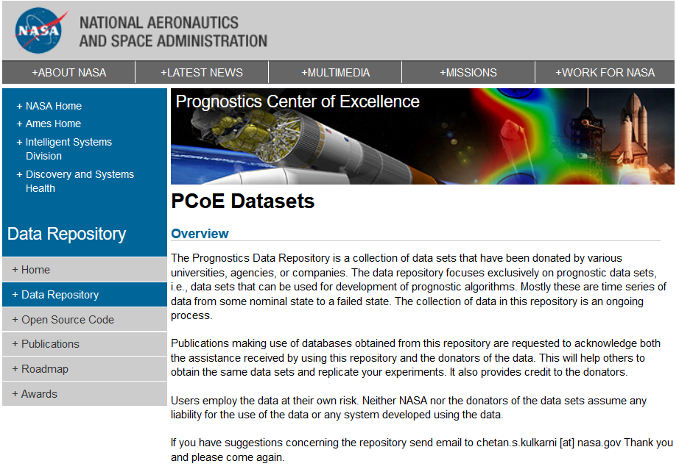
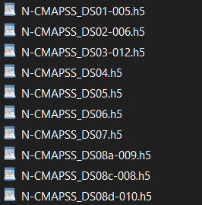
Dataset Acquisition
Run-to-failure trajectories:
-
13GB
New levels of fidelity incorporated:
Real flight conditions
Extends degradation model

Slide 5
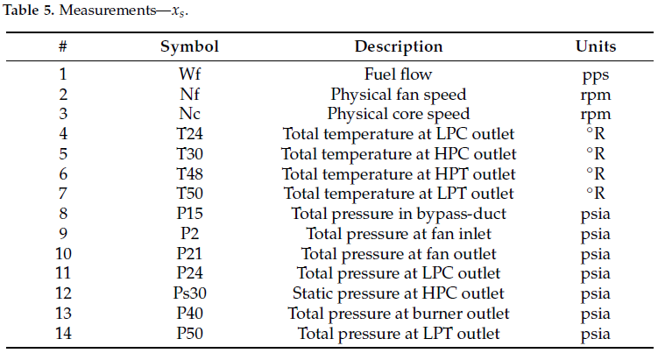
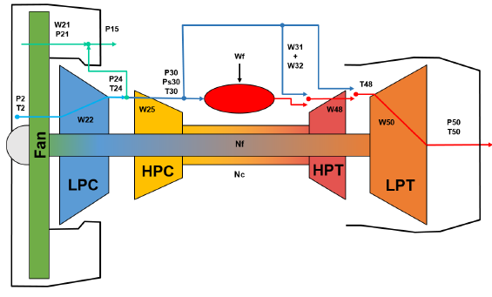
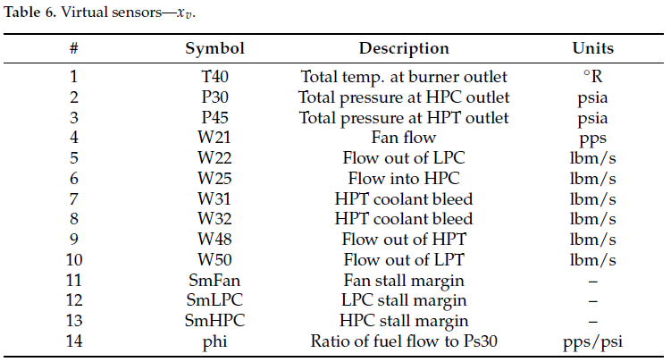
Dataset Analysis
Engine diagram component performance sensors

Slide 6

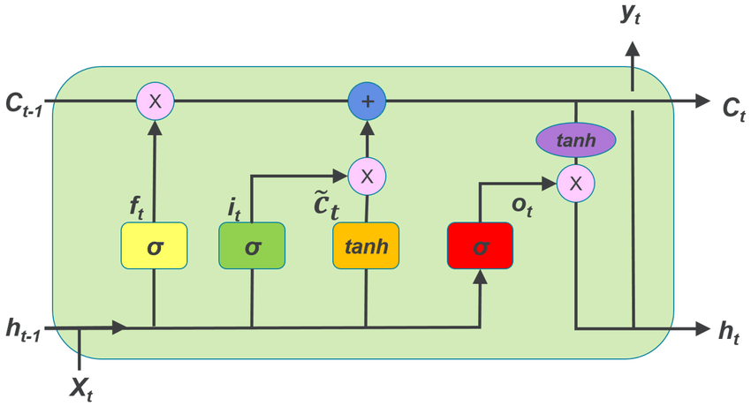
Modelling and Algorithms
Recent studies have started to apply Deep Learning Algorithms
Convolutional Neural Network (CNN)
Long Short-Term Memory Network (LSTM)
Hybrid of 2 models
CNN
LSTM

Slide 7
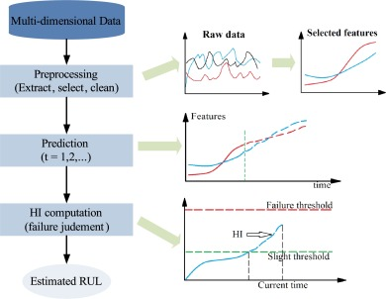
Results to be presented
Run-to-failure models to predict when the engine will face fault according to its performance.
(Prognostics)
Run-to-failure models to predict how the fault will evolve until critical situation
(Diagnostics)

Slide 8
Issues to be expected
Data available is in .h5 format
Deep Learning methodologies not yet taught
Frontend interface interactive?

Slide 9
Thanks for your attention

